Slide 1
Can We Predict Who Will Leave?

Slide 2
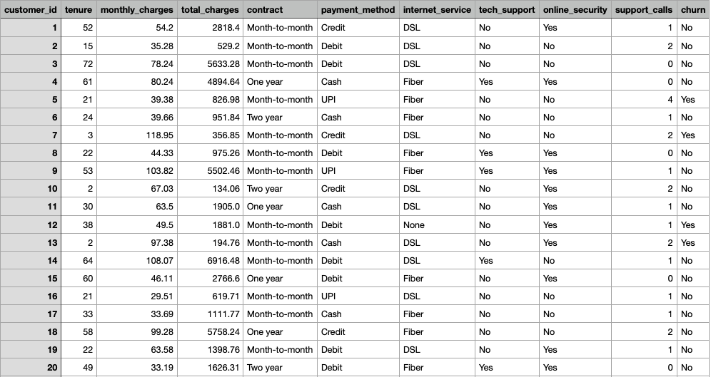
Key Features of the Dataset
20,000 Rows(Customer), 11 Columns
Target: churn (Yes/No) – Yes if customer has left
9 Features/ 4 numericals/ 5 Catergories

Slide 3
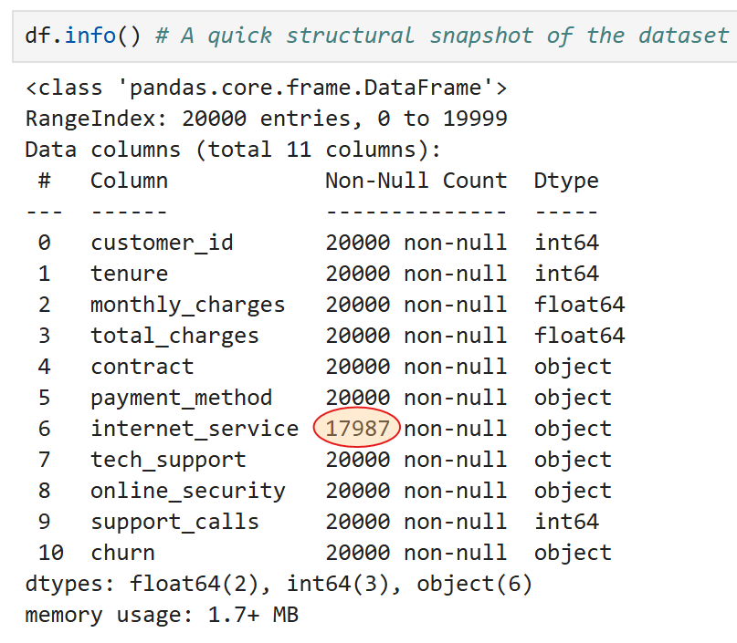
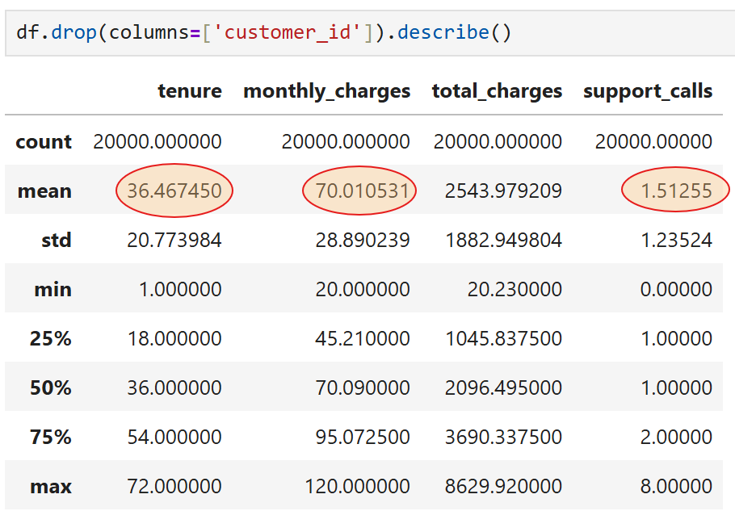
Preliminary Data Insight
Key Features
The Target (Churn)
Average tenure≈ 36 months
monthly charges ≈ 70 USD
support calls ≈ 1.5 (low overall)
20,000 − 17,987 = 2,013 missing / NaN

Slide 4
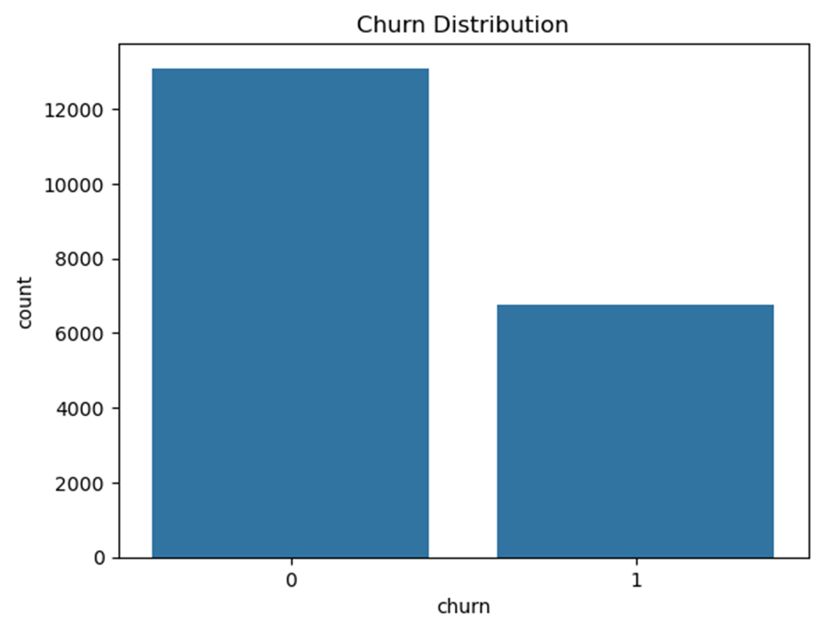
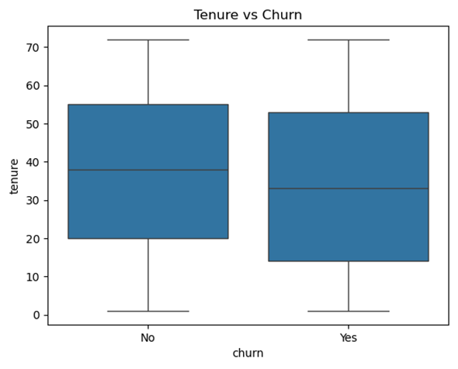
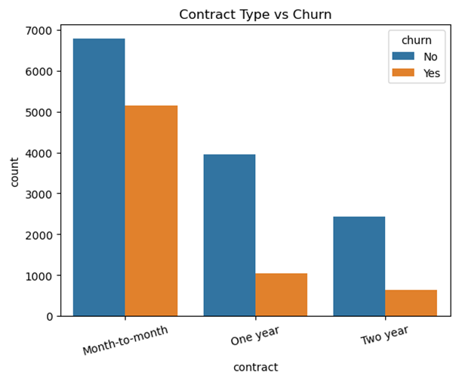
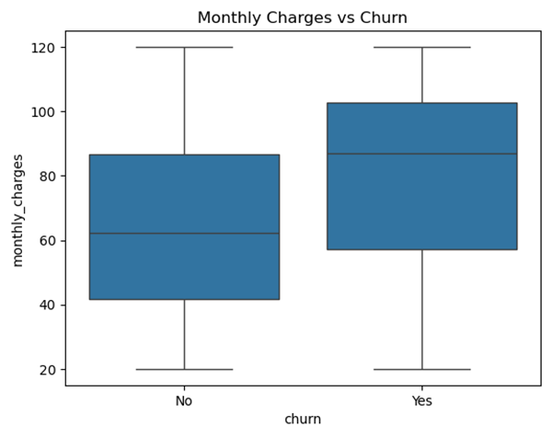
Exploring Feature Relationships
Churn Distribution
Tenure vs Churn
Monthly Charges vs Churn
Contract Type vs Churn

Slide 5
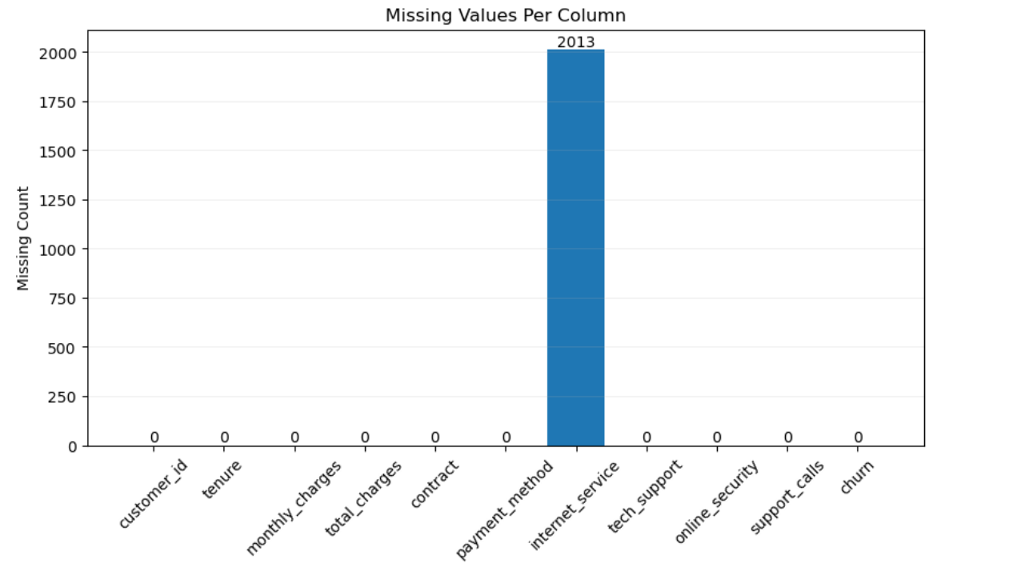
Preparing the Data
Checking for Missing Value
Dealing with Duplicates
Converting Categorical Features into Numerical ones
Detecting outliers

Slide 6
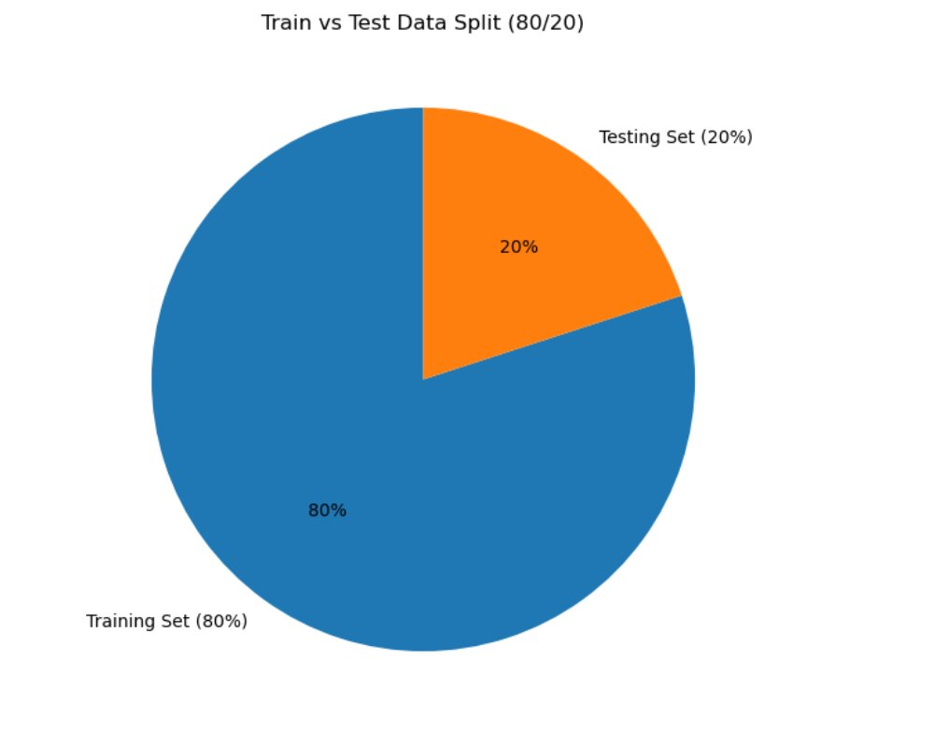
From Data to Predictions
Splitting the Data: Train and Test

Slide 7
Battle of the Models
Which one Predicts Best:
Logistic Regression
Decision Tree
Random Forest
Stochastic Gradient Descent
Support Vector Machine
Model | Recall | Precision | F1-score | Accuracy | Time taken
Logistic Regression | 72 | 57 | 63 | 71 | 0.49
Decision Tree | 59 | 62 | 60 | 73 | 0.02
Random Forest | 64 | 83 | 72 | 83 | 0.14
SGD | 70 | 56 | 62 | 71 | 0.09
SVM | 65 | 71 | 68 | 79 | 3.42

Slide 8
And the winner is ...
Logistic Regression model achieved the highest recall identifying 72% of churned customers.
Close behind, SGD performed similarly well, showing strong ability to detect churned customers with slightly lower recall 70%.
Given that recall is our priority, Logistic Regression is the best-performing model, followed closely by SGD. Decision Tree ()may be less suitable when missing churned customers is costly.

Slide 9
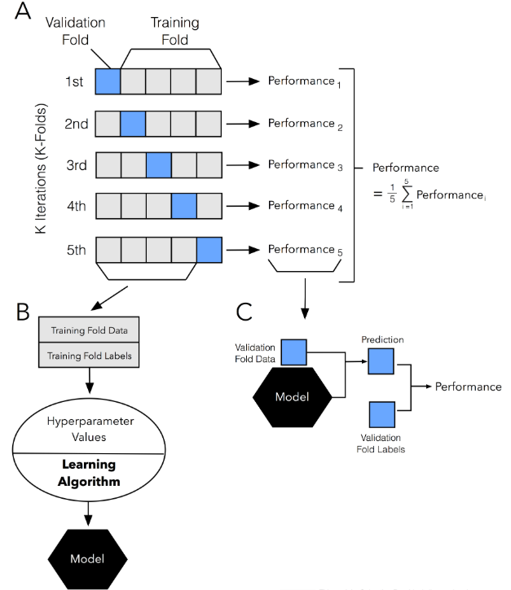
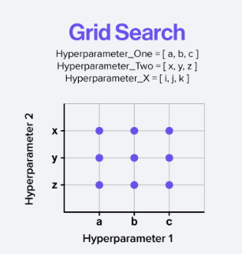
Fine Tuning using
GridSearchCV
Logistic Regression: C, max_iter
Decision Tree: criterion, max_depth
Random Forest: criterion, max_depth, n_estimators
SGD Classifier: alpha, max_iter, penalty
SVM: C, kernel

Slide 10
Precision Through Simplicity
Removing a non-impactful feature sharpened model focus by 1-3%
Model/Recall | Tuned | Simplified
Logistic Regression | 73.4% | 72%
Decision Tree | 67.8% | 65%
Random Forest | 64% | 66%
SGD | 73.50% | 71%
SVM | 72% | 70%

Slide 11
Improving Generalization & Focus
Model/Recall | Initial Fit | Tuned | Simplified
Logistic Regression | 72% | 73.4% | 72%
Decision Tree | 59% | 67.8% | 65%
Random Forest | 64% | 68.2% | 66%
SGD Classifier | 70% | 73.5% | 71%
SVM | 65% | 72% | 70%

Slide 12
Can We Predict Who Will Leave?

